Slide 2
Current child welfare services are costly and often result in separated families
Children suffering from maltreatment in the U.S.:
638,000
in 2015
430,333
children placed in foster/kinship care in 2015
HHS Children’s Bureau
HHS Children’s Bureau
In 2015, the U.S. spent approximately
$26.3 billion
on child welfare services and foster/kinship care
Open Minds

Slide 3

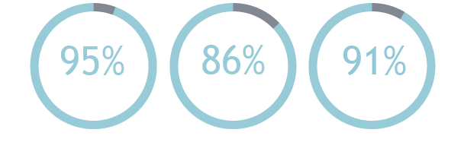
MST: Scientifically Proven to Transform Lives
MST Therapists work in the home, school and community to provide tailored interventions to risk factors that contribute to child abuse and neglect.
PROVEN RESULTS
60+ PUBLISHED STUDIES

Slide 4
MST-CAN & MST-BSF Overview
MST–CAN (Child Abuse and Neglect) Adaptation:
Families involved with child protective services due to physical abuse and/or neglect of a child in the family
Population:
Children 6-17
Treatment:
3+ sessions per week, lasting 6-9 months
Evidence:
4 studies
MST–BSF (Building Stronger Families) Adaptation:
Families involved with Child Protective Services due to co-occurring parental substance abuse and physical abuse and/or neglect
Population:
Children 6-17
Evidence:
Pilot study complete, effectiveness study underway
MST-CAN is rated as a “Supported” program by the California Evidence-Based Clearinghouse for Child Welfare

Slide 5
MST-CAN provides a tailored, holistic approach
Traditional Child Welfare Services
MST-CAN
Mental health needs
Parent
Parent or child
Identified risk factor
Multiple
risk factors
Child
Standardized approach
Community
Social ecology
Individualized approach, tailored to each family

Slide 6
Proven Cost Savings for Communities
ROI
$3.31
for every
dollar invested
MST DELIVERS
SUPERIOR CLINICAL &
FINANCIAL RESULTS
relative to
alternative treatments
NET BENEFIT
$26,655
per family
Administration and Policy in Mental Health and Mental Health Services Research

Slide 7
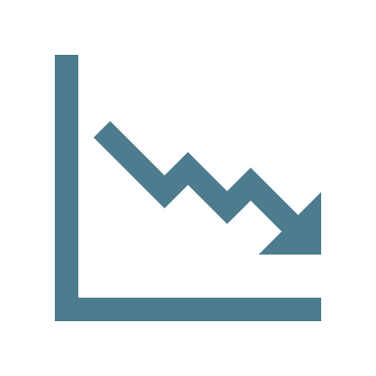





Proven Outcomes
Compared to enhanced outpatient therapy approaches, MST-CAN achieved
Fewer youths in out-of-home placements
Greater reduction in psychological aggression
Higher completion of treatment
Greater reduction in neglectful parenting
Greater reduction in minor and severe assault
Parents more likely to use nonviolent discipline

Slide 8







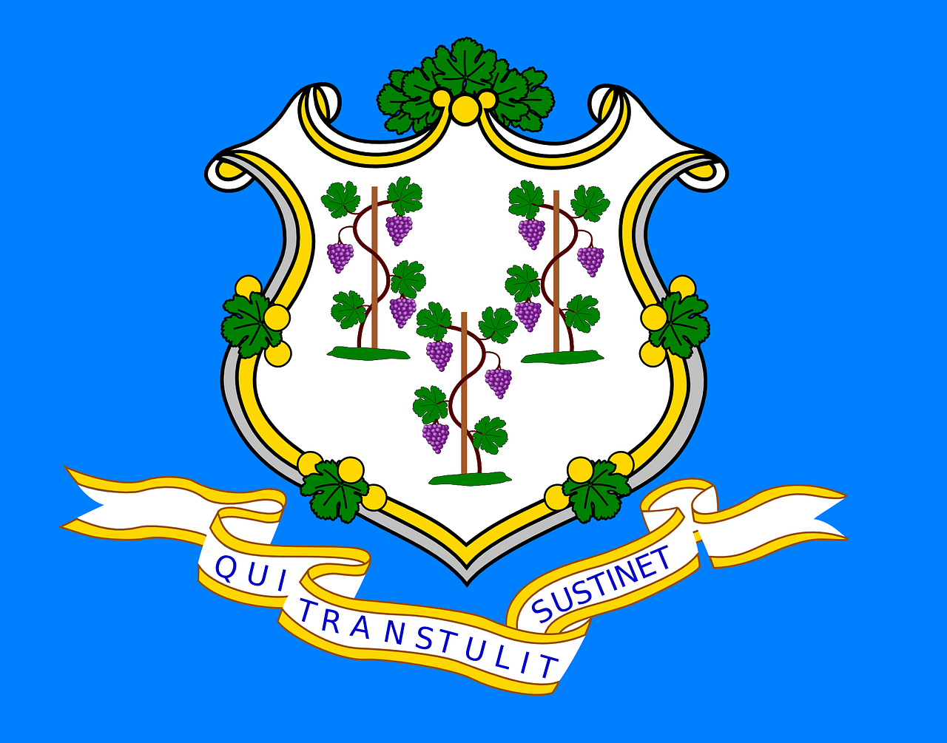



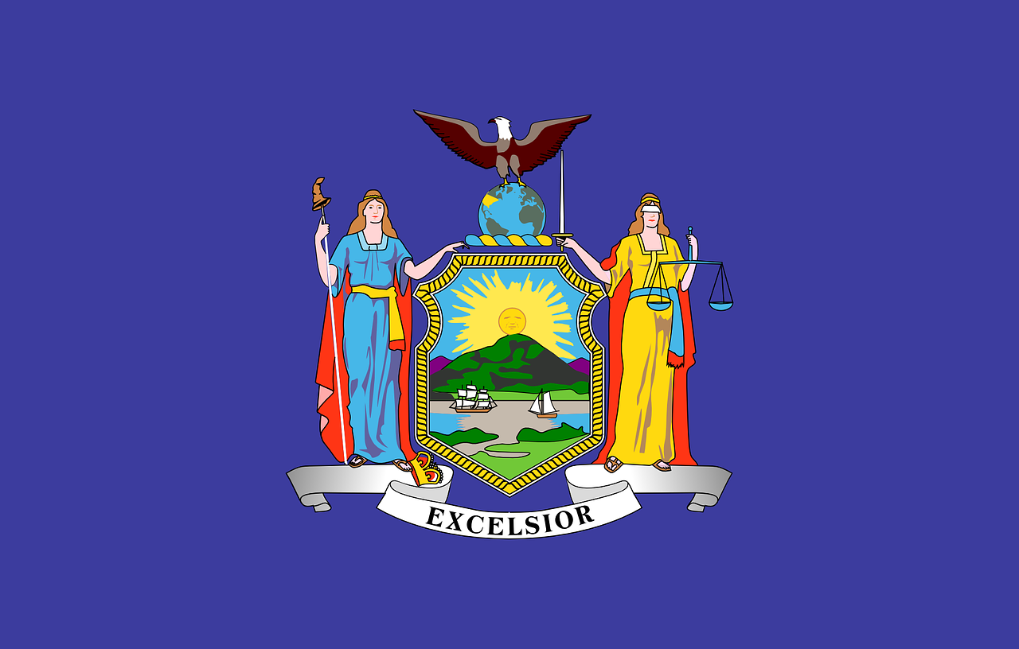
MST and MST-CAN have a global presence
MST’S GLOBAL REACH
15
34
2,500+
200,000+
COUNTRIES
STATES
CLINICIANS
YOUTH
MST-CAN is currently operating in 6 countries and 2 states
Countries
States
Connecticut
New York

Slide 9
How does MST-CAN work?
Staffing:
3 full time therapists
1 full time supervisor
1 full time crisis case worker
1 part-time psychiatrist
Training:
Therapists receive the standard 5-day MST Orientation and Training, and also receive a 4-day MST-CAN training that focuses on the treatment of adult and child trauma. Quarterly boosters follow cognitive behavioral models for adults and children, based on trauma focused cognitive behavioral therapy.
Approach:
MST-CAN provides a holistic approach to physical abuse and neglect cases by taking into account the wide range of possible risk factors and systems involved. MST-CAN focuses on families and communities as a whole, tailoring interventions to the social ecology surrounding the individual experiencing physical abuse or neglect.
Treatment Length:
6-9 months, provided in the home and community
Caseloads:
Therapists have caseloads of 3-4, and see on average 6 families a year
Quality Assurance:
MST Services provides comprehensive quality assurance services, ensuring that adherence to the MST-CAN model is maximized to deliver consistent, highest quality results.

Slide 10
Family First Prevention Services Act
Title VII of the Bipartisan Budget Act of 2018, the Family First Prevention Services Act (FFPSA), provides federal funds to states to provide services to prevent children from entering or re-entering foster care
The Act will support services
in three areas:
Mental Health
Substance Abuse Prevention and Treatment
In-Home Parent Skill-Based Programs
States will be evaluated on the following outcomes:
Percentage of candidates for foster care who do not enter foster care
Per child spending
Unlike federal foster care funds, FFPSA funds will not be dependent on the family’s income

Slide 11
FFSPA Funds are directed toward EBPs
Services must be trauma-informed, and evidenced-based according to the following categorizations
PROMISING
SUPPORTED
WELL-SUPPORTED
At least 1 study that was independently reviewed and validated
Study used a rigorous random-controlled trial or a quasi-experimental research design
Study was carried out in usual care or practice setting
Study found a sustained effect for at least 6 months beyond end of treatment
At least 2 studies that were independently reviewed and validated
Studies rigorous random-controlled trials or quasi-experimental research designs
Studies were carried out in usual care or practice setting
At least one study found a sustained effect for at least 1 year beyond end of treatment
At least 1 study that was independently reviewed and validated
Study used some form of control group to measure outcomes
MST-CAN is a “Supported” practice and states may be able to use FFSPA funds to support MST-CAN programs
Notes:
Note – Next update of information on implementation of the Act is due in October, 2018; more details and guidance will be presented then.

Slide 12
Bring MST-CAN to your community
CONVENE
stakeholders to ensure collaboration and engagement in starting a successful MST program
Our Program Development staff will walk you through all aspects of team start-up, from estimating costs, to assessing site readiness, to hiring and training quality team members
ASSESS
level of service needed in your community to determine the number of teams to start
IDENTIFY
A provider organization
SECURE
sustainable funding sources and develop a comprehensive budget for your program

Slide 13
Charleston
710 Johnnie Dodds Blvd, Ste 200
Mount Pleasant, SC 29464
Atlanta
3490 Piedmont Rd NE, Ste 1250
Atlanta, GA 30305
San Francisco
1100 Moraga Way, Suite 202
Moraga, CA 94556
info@mstservices.com
www.mstservices.com
843.856.8226

