Slide 2
Incarceration: Ineffective and Costly
U.S. cost per youth incarcerated:
$115,000
per year
70-80%
of juveniles sent to youth prisons are re-arrested within 2 years
Justice Policy Institute
Annie E. Casey Foundation
Each year, the U.S. loses between
$8 billion and $21 billion
due to incarceration of youth
Justice Policy Institute

Slide 3

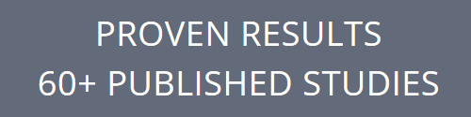
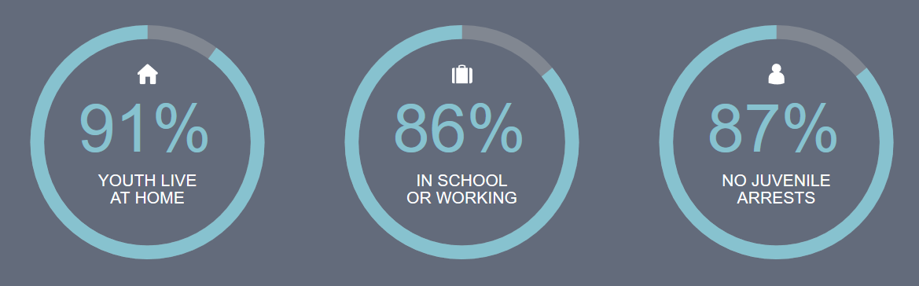

MST: Scientifically Proven to Transform Lives
MST Therapists work in the home, school and community and are on call 24/7 to provide caregivers with the tools they need to transform the lives of troubled youth.

Slide 4

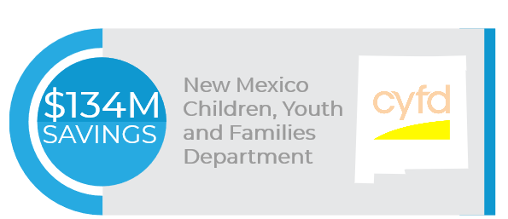
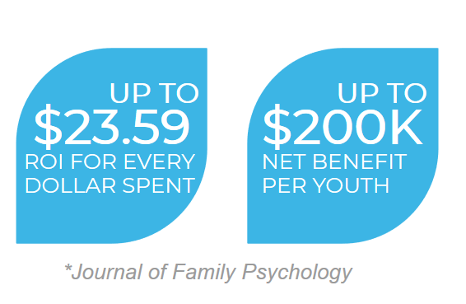
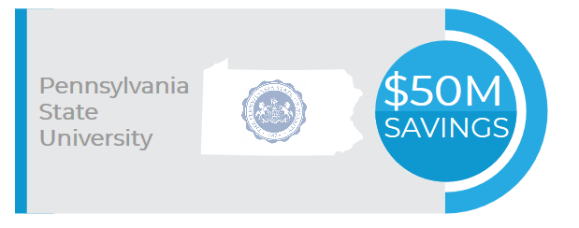
Dramatic Cost Savings for Communities
RECENT STATE COST SAVINGS REPORTS

Slide 5


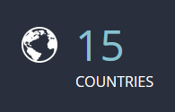
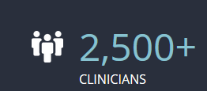
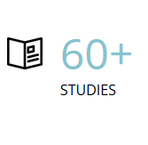
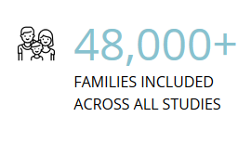
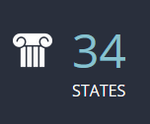
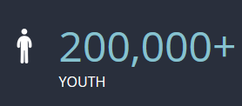
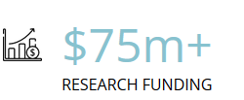
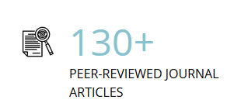
Proven Results & Low Investment Risk
MST FEATURES THE LARGEST BODY OF EVIDENCE, BY FAR, OF SUCCESSFUL INTERVENTIONS FOR HIGH RISK YOUTH
GLOBAL REACH
BODY OF EVIDENCE
MST IS THE ONLY INTERVENTION FOR HIGH RISK YOUTH WHERE RESULTS HAVE BEEN REPEATEDLY REPLICATED BY INDEPENDENT RESEARCH TEAMS

Slide 6
MST Addresses Root Causes of Negative Behavior
Entire Ecology
Focus on Caregivers
MST focuses on the entire ecology of youths’ lives, addressing multiple factors that contribute to antisocial behavior, including factors at the family, school and community levels
MST empowers caregivers to be long-term change agents, creating more sustainable effects than treatment methods focused solely on youths
Quality Assurance Yielding Consistent Results
MST Services provides comprehensive quality assurance services, ensuring that adherence to the MST model is maximized to deliver consistent, highest quality results

Slide 7


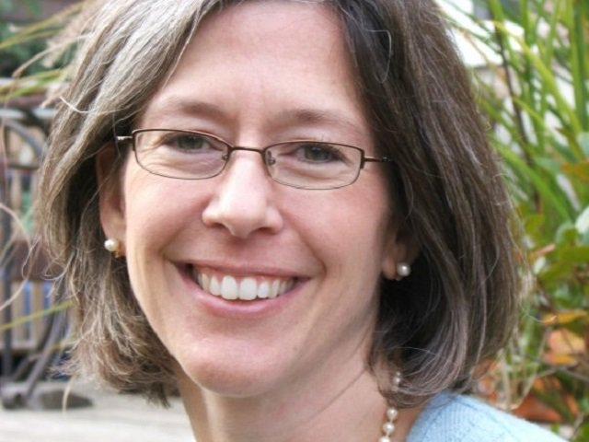


Endorsements and Testimonials
“My daughter will always come back to MST and say that’s the best thing to happen to us – and that’s the truth”
MST Mother
BLUEPRINTS FOR HEALTHY YOUTH DEVELOPMENT
University of Colorado Behavioral Science has reviewed more than 1,400 youth programs, and has ranked MST one of only two programs as a model plus (top rating)
“It was easy to champion MST. It's what I'd want if my daughter were to find herself in the spot that so many do.”
Julie Revaz, Connecticut Judicial Branch

Slide 8

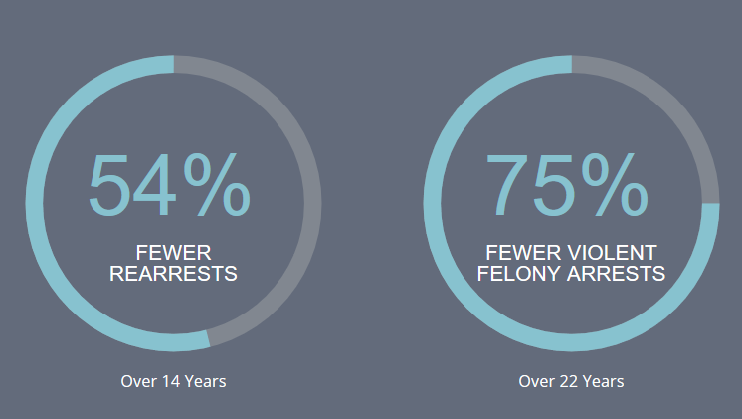

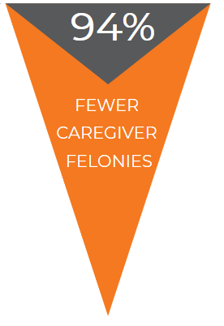
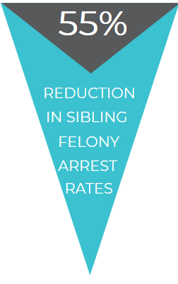
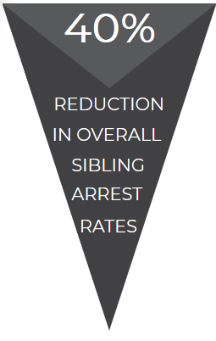
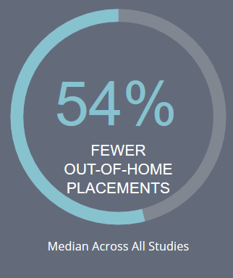
Enduring Results for the Entire Family
LASTING RESULTS FOR YOUTH TREATED
MST BENEFITS THE WHOLE FAMILY
Over 14 Years
Over 22 Years
Median Across All Studies
Journal of Consulting and Clinical Psychology
Missouri Delinquency Project

Slide 9
Bring MST to your community
CONVENE
stakeholders to ensure collaboration and engagement in starting a successful MST program
Our Program Development staff will walk you through all aspects of team start-up, from estimating costs, to assessing site readiness, to hiring and training quality team members
ASSESS
level of service needed in your community to determine the number of teams to start
IDENTIFY
A provider organization
SECURE
sustainable funding sources and develop a comprehensive budget for your program

Slide 10
Charleston
710 Johnnie Dodds Blvd, Ste 200
Mount Pleasant, SC 29464
Atlanta
3490 Piedmont Rd NE, Ste 1250
Atlanta, GA 30305
San Francisco
1100 Moraga Way, Suite 202
Moraga, CA 94556
info@mstservices.com
www.mstservices.com
843.856.8226

